Slide 1
Development of a MIPS Machine Simulator
By Mike Zhong
CS575 Operating Systems
Professor Zhang

Slide 2
Motivation
Best way to understand the machine is to build one
Previously took a course on Computer Architecture and Assembly Language, MIPS was the language used
Used MIPS to write application level programs, not fun, but gain valuable insight into basic machine level instructions
MIPS is a great assembly language for learning because all instructions are the same size (32-bit) and is easier to understand than x86

Slide 3
Instruction Set Architecture
http://www.mrc.uidaho.edu/mrc/people/jff/digital/MIPSir.html
Not going to implement every instruction, just some
Three types of instructions, R-type, I-type, and J-type
All instructions are 32-bit

Slide 4
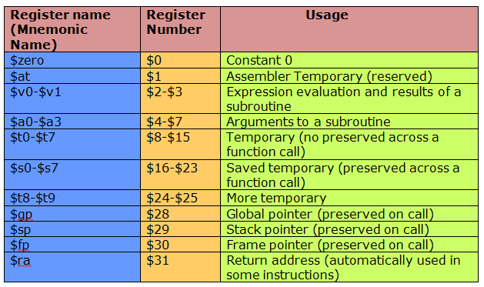
Registers
32 registers, $0 - $31
Registers are addressed by their number, e.g- register 0x10 is register $16
http://www.skidmore.edu/~pvonk/mips/lessons/registers.html

Slide 5
R-type Instructions
R-type instructions have the following format: (bits)
Opcode (6), Source 1 (5), Source 2 (5), Destination (5), Shift (5), Function (6)
E.g – 000000 01000 01001 01000 00000 100000
How do we read this?
000000 – opcode for ALU, the function specifies operation
01000 – First source register, register $8
01001 – Second source register, register $9
01000 – Destination register, register $8
Shift – 0, since this is not a shift operation
100000 – ‘add’ operation
add $8, $8, $9 => $8 = $8 + $9

Slide 6
I-type Instructions
I-type instructions have the following format: (bits)
No function needed since each I-type instruction has its unique opcode
16-bit field for can be used for addressing or immediates depending on the instruction
Opcode (6), Source (5), Target (5), Address Offset/Imm (16)
E.g – 001000 01000 01000 0000000000000011
How do we read this?
001000 – Opcode for addi (add intermediate)
01000 – source register $8
01000 – target register $8
0000000000000011 – immediate value, this gets sign extended to 32 bits and added to the value in register $8, then result stored in register $8
This instruction type is also used for the common load word (lw) and store word (sw) operations, where the address offset is used to specify location in memory

Slide 7
J-type Instructions
J-type instructions have the following format: (bits)
Only two instructions are J-type
Opcode (6), target (26)
Eg. 000010 00000000000000000000000001
How do we read this?
000010 – opcode for j (opcode for jal is 000011)
00000000000000000000000001 – coded address of the label

Slide 8
Addressing Modes in MIPS
What are the different ways to access an operand?
Register addressing: simplest way, operand exists in a register and can be addressed by the name/number of the register
E.g – add $s0, $s1, $s2 ➔ $s0 = $s1 + $s2
Base addressing: operand is in memory, the address is located at the sum of the value in the register and a constant, can be direct or indirect
E.g – lw $s1, 32($s2) ➔ $s1 = memory[$s2 + 32]
Immediate addressing: operand is an immediate. NOTE: in this type of instruction, the immediate (7) is actually a part of the instruction
E.g – addi $s0, $s0, 7 ➔ $s0 = $s0 + 7
Program counter relative addressing: operand is pc + offset

Slide 9
Design
Create structs and unions to represent machine’s memory and registers
Create functions to implement the instructions. All instructions have the same function prototype (in terms return type, number of arguments, and argument type
void instruction (instruction, memory*)
Since all instructions are 32-bit, we can use a union to store any type of instruction, we break down the union into one of three possible structs, corresponding to the 3 instruction types
Main program is very basic: specify program to run in argv[1], main will load the program into memory, then begin fetching instructions, decoding instructions, and executing
Because all instructions share the same function prototype, function pointers can be used
Void (*get_instruction (instruction)) (instruction, memory*)
Function takes an argument instruction, this instruction is used in the argument and returns a function pointer which takes an instruction and memory* as arguments and returns void <whew>
void (*specific_instruction (opcode)) (instruction, memory*)
Specific_instruction is a function which takes opcode and returns a function pointer which takes instruction and memory* and returns void

Slide 10
Implementation
All instructions implemented using information from the URL below:
http://www.mrc.uidaho.edu/mrc/people/jff/digital/MIPSir.html
NOTE: system calls not implemented
Programs to be loaded are not actually machine code files derived from MIPS assembly source code, rather, it is just text files with 0’s and 1’s representing the text and data portions of actual programs, this was done to test the functionality of the instructions as well as easily provide instructions of the users choice
Main() will start by malloc’ing space for the machines memory and setting all bits to 0
Then, it will load the program by reading in lines of 32 chars (0 or 1), each line will then be converted into a uint32_t, encoding one instruction
Next, the program counter will iterate through memory until it reaches an instruction of 0x00, indicating the end of the instructions
Currently still in testing so after each instruction, the contents of the register will print out and the user must press “enter” to fetch and execute the next instruction

Slide 11
Implementation cont’d
Basic fetch/execute cycle:
1) fetch instruction, if instruction == 0x00, end program
2) declare f_ptr and assign the return value of get_instruction() to it
3) get_instruction() will check the opcode and call the get_x_instruction() with the opcode/function as argument
4) get_x_instruction() where x = R, I, J will then return a pointer to the function which performs the basic instruction, which gets assigned to f_ptr
5) call f_ptr(instruction, memory*) to execute instruction

Slide 12
Concluding Remarks and Next Steps
Still need to test it using strings of ‘0’ and ‘1’ to mimic machine code
Ideally would write unit tests for each instruction but ran out of time
Stack pointer, and other specialized registers are not implemented

Slide 13
Sample Code
void lw(instruction i, memory* p); // I-TYPE
void add(instruction i, memory* p); // R-TYPE
void jal(instruction i, memory* p); // J-TYPE
static inline void (*get_instruction(instruction i))(instruction, memory*) // given an instruction, checks opcode and calls get_x_instruction, returns the RV of get_x_instruction
static inline void (*get_r_instruction(uint32_t opcode))(instruction, memory*) // returns function pointer to specific R-type instruction

